Slide 1
AZ-104T00A Administer PaaS Compute Options
Notes:
This was previously called Serverless Computing. Changing the title is the only difference.

Slide 2




Administer PaaS Compute Options Introduction
Configure Azure App Service Plans
Configure Azure App Services
Configure Azure Container Instances
Configure Azure Kubernetes Service
Lab 09a - Implement Web Apps
Lab 09b - Implement Azure Container Instances
Lab 09c - Implement Azure Kubernetes Service (optional)
Notes:
Module overview

Slide 3
Configure Azure App Service Plans

Slide 4

Configure Azure App Service Plans Introduction
Implement Azure App Service Plans
Determine App Service Plan Pricing
Scale Up and Scale Out the App Service Plan
Configure App Service Plan Scaling
Demonstration – Create an App Service Plan
Summary and Resources
Notes:
Deploy and manage Azure compute resources (20–25%)
Create and configure Azure App Service
* Create an App Service.
* Secure an App Service.
* Configure custom domain names.
* Configure backup for an App Service.
* Configure networking settings.
* Configure deployment settings.

Slide 5
Implement Azure App Service Plans
Define a set of compute resources for a web app to run
Determines performance, price, and features
One or more apps can be configured to run in the same App Service plan
Region where compute resources will be created
Number of virtual machine instances
Size of virtual machine instances
Pricing tier (next slide)
Notes:
Azure App Service plan overview - https://docs.microsoft.com/azure/app-service/overview-hosting-plans

Slide 6
Determine App Service Plan Pricing
Selected Features | Free | Shared (dev/test) | Basic (dedicated dev/test) | Standard (production workloads) | Premium (enhanced scale and performance) | Isolated (high-performance, security and isolation)
Web, mobile, or API apps | 10 | 100 | Unlimited | Unlimited | Unlimited | Unlimited
Disk space | 1 GB | 1 GB | 10 GB | 50 GB | 250 GB | 1 TB
Auto Scale | – | – | – | Supported | Supported | Supported
Deployment Slots | 0 | 0 | 0 | 5 | 20 | 20
Max Instances | – | – | Up to 3 | Up to 10 | Up to 30 | Up to 100
Shared compute (Free and Shared). Run apps on the same Azure VM as other App Service apps, and the resources cannot scale out
Dedicated compute (Basic, Standard, Premium). Run apps in the same plan in dedicated Azure VMs
Isolated. Runs apps on dedicated Azure VMs in dedicated Azure virtual networks
Notes:
App Service pricing - https://azure.microsoft.com/pricing/details/app-service/windows/

Slide 7
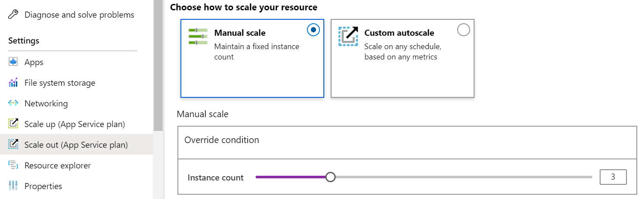
Scale Up and Scale Out the App Service Plan
Scale up (change the App Service plan):
More hardware (CPU, memory, disk)
More features (dedicated virtual machines, staging slots, autoscaling)
Scale out (increase the number of VM instances):
Manual (fixed number of instances)
Auto scale (based on predefined rules and schedules)
Notes:
Scale up an app in Azure App Service - https://docs.microsoft.com/azure/app-service/manage-scale-up

Slide 8
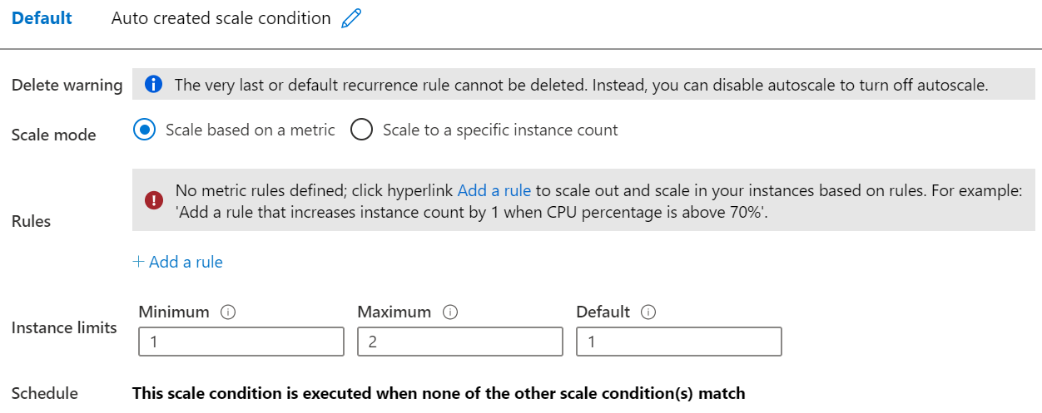
Configure App Service Plan Scaling
Adjust available resources based on the current demand
Improves availability and fault tolerance
Scale based on a metric (CPU percentage, memory percentage, HTTP requests)
Scale according to a schedule (weekdays, weekends, times, holidays)
Can implement multiple rules – combine metrics and schedules
Don’t forget to scale in
Notes:
Get started with Autoscale in Azure - https://docs.microsoft.com/azure/azure-monitor/platform/autoscale-get-started?toc=/azure/app-service/toc.json

Slide 9
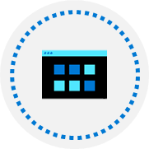
Demonstration – Create an App Service plan
Create an App Service Plan in the Azure Portal
Review Pricing Tiers
Configure Autoscaling
Notes:
✔ Always consider having students walk-through the demonstrations themselves. Also, consider the overlap with the formal labs and your best use of time.

Slide 10
Summary and Resources – Configure Azure App Service Plans
Knowledge Check Questions
Microsoft Learn Modules (docs.microsoft.com/Learn)
Scale an App Service web app to efficiently meet demand with App Service scale up and scale out
Notes:
Learn - https://docs.microsoft.com/learn/browse
The Assessment Guide in the MCT DLC has open-ended questions.
What is an App Service Plan and what will you consider in deciding which plan to choose?
Answer: An App Service Plan defines a set of compute resources for a web app to run. The plan determines performance, price, and features for a web app. Considerations for which plan to choose include how many web apps you can have, the disk space available to the web apps, if the web app can autoscale, how many deployment slots are available, and how many web app instances can be created.

Slide 11
Configure Azure App Services

Slide 12
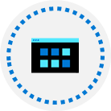


Configure Azure App Services Introduction
Implement Azure App Service
Create an App Service
Create Deployment Slots
Add Deployment Slots
Secure an App Service
Create Custom Domain Names
Backup an App Service
Demonstration – Create an App Service
Summary and Resources
Notes:
Deploy and manage Azure compute resources (25-30%)
Create and configure Web Apps
Create and configure App Service
Create and configure App Service Plans

Slide 13
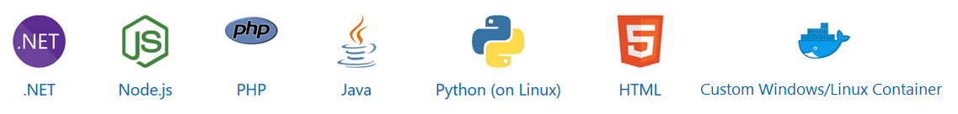
Implement Azure App Service
Includes Web Apps, API Apps, Mobile Apps, and Function Apps
Fully managed environment enabling high productivity development
Platform-as-a-service (PaaS) offering for building and deploying highly available cloud apps for web and mobile
Platform handles infrastructure so developers focus on core web apps and services
Developer productivity using .NET, .NET Core, Java, Python and a host of others
Provides enterprise-grade security and compliance
Notes:
App Service - https://azure.microsoft.com/services/app-service/

Slide 14
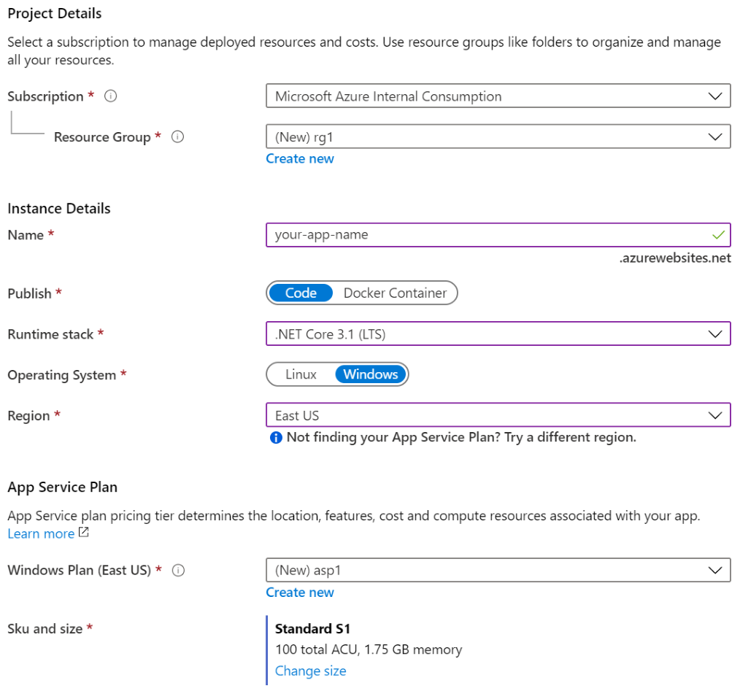
Create an App Service
Name must be unique
Access using azurewebsites.net – can map to a custom domain
Publish Code (Runtime Stack)
Publish Docker Container
Linux or Windows
Region closest to your users
App Service Plan
Notes:
Manage an App Service plan in Azure - https://docs.microsoft.com/azure/app-service/app-service-plan-manage

Slide 15



Create Deployment Slots
Service Plan | Slots
Free, Shared, Basic | 0
Standard | Up to 5
Premium | Up to 20
Isolated | Up to 20
Continuous Deployment with Stage Slot
Developer 1
GitHub
Swap
Staging
Production
Developer 2
Deploy to a different deployment slots (depends on service plan)
Validate changes before sending to production
Deployment slots are live apps with their own hostnames
Avoids a cold start – eliminates downtime
Fallback to a last known good site
Auto Swap when pre-swap validation is not needed
Notes:
Set up staging environments - https://docs.microsoft.com/azure/app-service/web-sites-staged-publishing?toc=%2Fazure%2Fapp-service%2Ftoc.json#add-a-deployment-slot
App Service Web App – block web access to non-production deployment slots - http://ruslany.net/2014/04/azure-web-sites-block-web-access-to-non-production-deployment-slots/
✔ Each App Service plan mode supports a different number of deployment slots. To find out the number of slots your app’s mode supports, see App Service Limits.

Slide 16
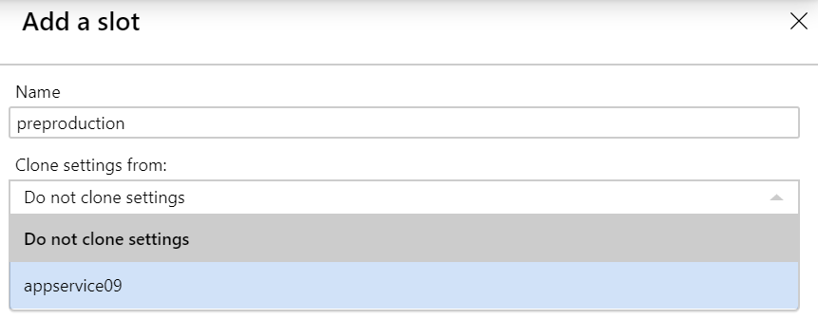
Add Deployment Slots
Select whether to clone an app configuration from another deployment slot
When you clone, pay attention to the settings:
Slot-specific app settings and connection strings
Continuous deployment settings
App Service authentication settings
Not all settings are sticky (endpoints, custom domain names, SSL certificates, scaling)
Review and edit your settings before swapping
Notes:
✔ You can configure app settings and connections to stick to a slot and not be swapped. This done in the App Settings blade. A developer can create new settings for the web app.

Slide 17
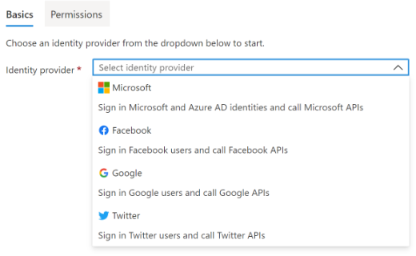
Secure an App Service
Authentication:
Enable authentication – default anonymous
Log in with a third-party identity provider
Security:
Troubleshoot with Diagnostic Logs – failed requests, app logging
Add an SSL certificate – HTTPS
Define a priority ordered allow/deny list to control network access to the app
Store secrets in the Azure Key Vault
Notes:
Security recommendations for App Service - https://docs.microsoft.com/azure/app-service/security-recommendations

Slide 18
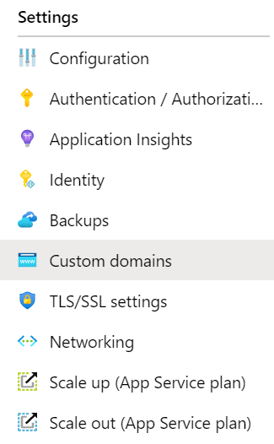
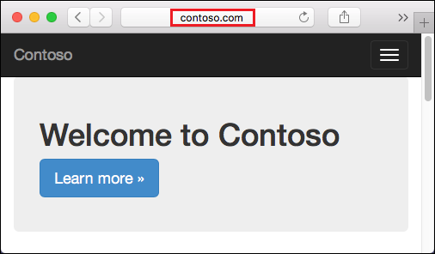
Create Custom Domain Names
Redirect the default web app URL
Validate the custom domain in Azure
Use the DNS registry for your domain provider – create a CNAME or A record with the mapping
Ensure App Service plan supports custom domains

Slide 19
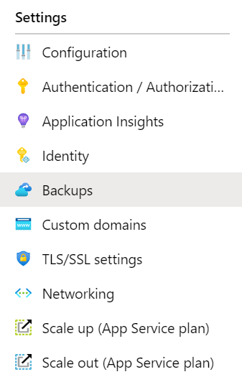
Backup an App Service
Create app backups manually or on a schedule
Backup the configuration, file content, and database connected to the app
Requires Standard or Premium plan
Backups can be up to 10 GB of app and database content
Configure partial backups and exclude items from the backup
Restore your app on-demand to a previous state, or create a new app
Notes:
Back up your App in Azure - https://docs.microsoft.com/azure/app-service/web-sites-backup
Configure partial backups - https://docs.microsoft.com/azure/app-service/web-sites-backup

Slide 20
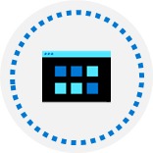
Demonstration – Create an App Service
Create a Web App in the Azure Portal
Test the Web App
Configure Deployment Slots
Configure Backup
Notes:
✔ Always consider having students walk-through the demonstrations themselves. Also, consider the overlap with the formal labs and your best use of time.

Slide 21
Summary and Resources – Configure Azure App Services
Knowledge Check Questions
Microsoft Learn Modules (docs.microsoft.com/Learn)
Host a web application with Azure App Service (Sandbox)
Stage a web app deployment for testing and rollback by using App Service deployment slots
Dynamically meet changing web app performance requirements with autoscale rules
A sandbox indicates a hands-on exercise.
Notes:
Learn - https://docs.microsoft.com/learn/browse
The Assessment Guide in the MCT DLC has open-ended questions.
List at least three administrator tasks for an organization’s web app.
If you are administering an Azure web app you will need to monitor, secure, and backup the app. Monitoring includes usage stats, outages, page views, user sessions, performance, and troubleshooting. Securing tasks include access, authentication, certificates, and identity. Backup decisions make sure all parts of the app can be restored, as well as frequency of the backups. Creating a custom domain name is another important task; there are certainly other important tasks.

Slide 22
Configure Azure Container Instances

Slide 23

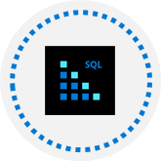
Configure Azure Container Instances Introduction
Compare Containers to Virtual Machines
Explore Azure Container Instances Benefits
Implement Container Groups
Understand the Docker Platform
Demonstration – Deploy Azure Container Instances
Summary and Resources
Notes:
Deploy and manage Azure compute resources (20–25%)
Create and configure containers
* Configure sizing and scaling for Azure Container Instances.
* Configure container groups for Azure Container Instances.

Slide 24
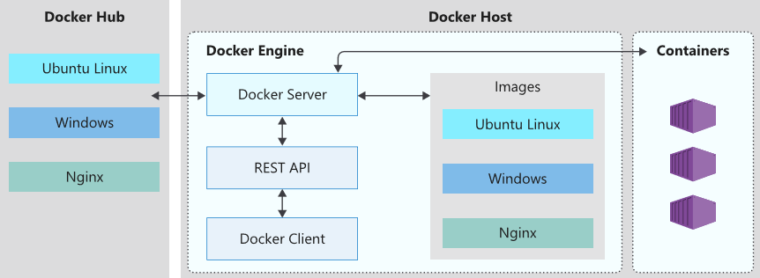
What is a Container?
Docker is a Container runtime engine used widely within the industry to run container workloads.
Docker configurations are defined in Dockerfiles. Docker Container Images are produced from Dockerfiles and used to run containers in the cloud
Notes:
A container is essentially a standalone package that contains everything that is needed to execute a piece of software. The package includes:
The application executable code.
The runtime environment (such as .NET Core).
System tools.
Settings.
https://www.youtube.com/watch?v=pTFZFxd4hOI
https://www.youtube.com/watch?v=s_o8dwzRlu4

Slide 25
Compare Containers to Virtual Machines
VM
VM
Isolation
Operating System
Deployment
Persistent storage
Fault tolerance
Container
Container
App A
App B
Bins/Libs
Bins/Libs
App A
App A
App B
App B
Guest OS
Guest OS
Bins/Libs
Bins/Libs
Hypervisor
Host OS
Server
Notes:
This slide replaces a text heavy table slide. The older slide with discussion points is at the end of presentation.
Containers vs. virtual machines - https://docs.microsoft.com/virtualization/windowscontainers/about/containers-vs-
Hardware virtualization has made it possible to run multiple isolated instances of operating systems concurrently on the same physical hardware. Containers represent the next stage in the virtualization of computing resources. Container-based virtualization allows you to virtualize the operating system. This way, you can run multiple applications within the same instance of an operating system, while maintaining isolation between the applications. This means that containers within a VM provide functionality similar to that of VMs within a physical server. To better understand this concept, it is helpful to compare containers and virtual machines.

Slide 26
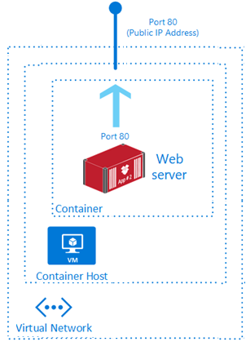
Explore Azure Container Instances Benefits
PaaS Service
Fast startup times
Public IP connectivity and DNS name
Isolation features
Custom sizes
Persistent storage (Azure Files)
Linux and Windows Containers
Co-scheduled Groups
Virtual network Deployment
Fastest way to run a container in Azure without provisioning a VM
Notes:
What is Azure Container Instances? - https://docs.microsoft.com/azure/container-instances/container-instances-overview

Slide 27
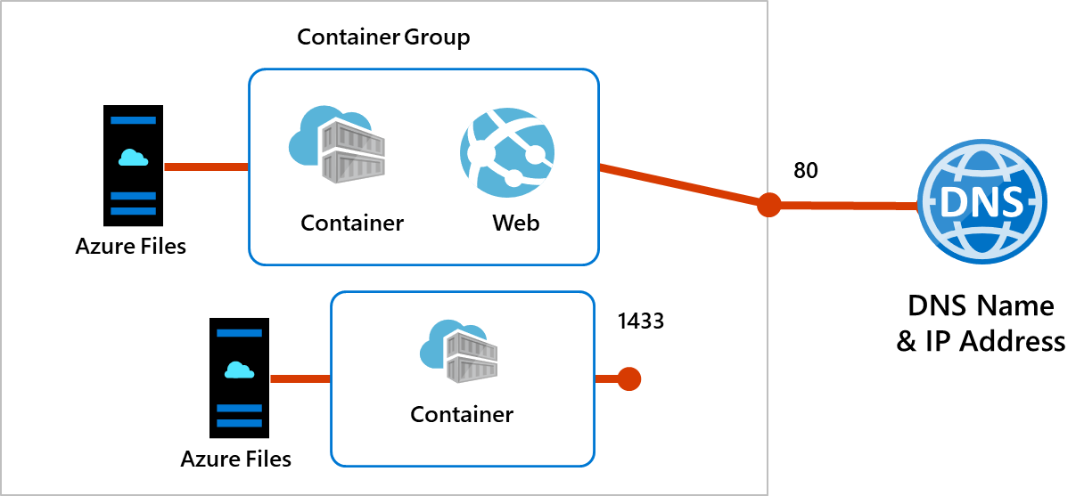
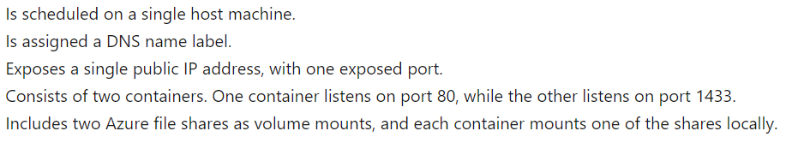
Implement Container Groups
Top-level resource in Azure Container Instances
A collection of containers that get scheduled on the same host
The containers in the group share a lifecycle, resources, local network, and storage volumes
Notes:
Quickstart: Deploy a container instance in Azure using the Azure portal - https://docs.microsoft.com/azure/container-instances/container-instances-quickstart-portal
A container group is a collection of containers that get scheduled on the same host machine. The containers in a container group share a lifecycle, resources, local network, and storage volumes.

Slide 28

Understand the Docker Platform
Enables developers to host applications within a container
A container is a standardized “unit of software“ that contains everything required for an application to run
Available on both Linux and Windows and can be hosted on Azure
Notes:
Docker on Azure - https://azure.microsoft.com/services/kubernetes-service/docker/

Slide 29

Demonstration - Deploy Azure Container Instances
Create a container instance
Verify deployment of the container instance
Notes:
✔ Always consider having students walk-through the demonstrations themselves. Also, consider the overlap with the formal labs and your best use of time.

Slide 30
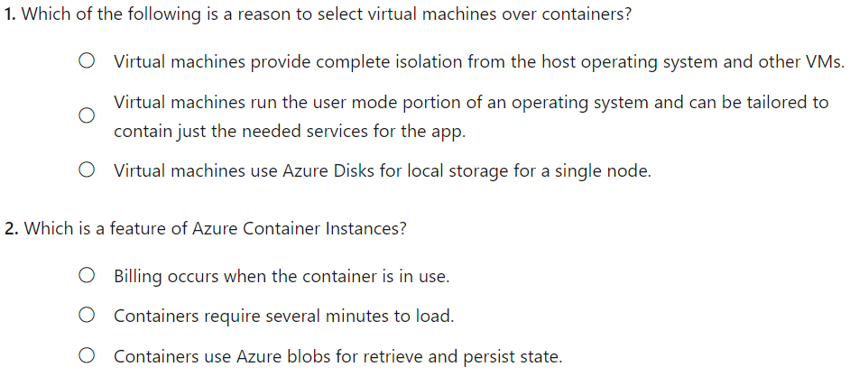
Knowledge Check

Slide 31
Summary and Resources – Configure Azure Container Instances
Knowledge Check Questions
Microsoft Learn Modules (docs.microsoft.com/Learn)
Run Docker containers with Azure Container Instances
Build a containerized web application with Docker
Notes:
Learn - https://docs.microsoft.com/learn/browse
The Assessment Guide in the MCT DLC has open-ended questions.
Describe at least two differences between containers and virtual machines.
Answer: Containers provide only lightweight isolation, whereas VMs provide complete isolation. VMs run the entire operating systems, but containers only run the OS services that are needed. Containers are deployed with Docker and orchestrated with Azure Kubernetes service. VMs are deployed and managed different tools with Azure. Containers can use local disk storage or file shares. VMs use a virtual hard disk and file shares.

Slide 32
Configure Azure Kubernetes Service

Slide 33
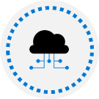

Configure Azure Kubernetes Service Introduction
Understand AKS Terminology
Understand AKS Clusters and Nodes
Configure AKS Networking
Configure AKS Storage
Configure AKS Scaling
Configure AKS Scaling to ACI (optional)
Demonstration – Deploy Azure Kubernetes Service (optional)
Summary and Resources
Notes:
Instructor – the number of slides in this lesson has been reduced. Removed slides are at the end.
Deploy and manage Azure compute resources (20–25%)
Create and configure containers
* Configure storage for Azure Kubernetes Service (AKS).
* Configure scaling for AKS.
* Configure network connections for AKS.
* Upgrade an AKS cluster.

Slide 34
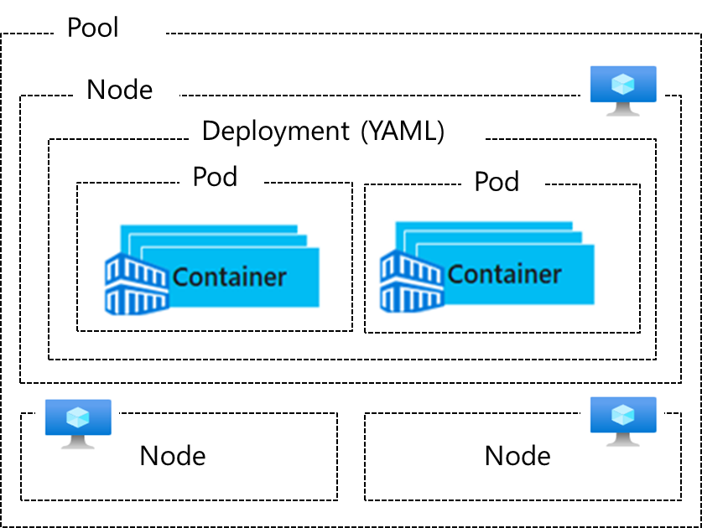
Understand AKS Architecture
Term | Description
Pools | Groups of nodes with identical configurations
Nodes | Individual VMs running containerized applications
Pods & Replicas | Single instance of an application. A pod can contain multiple containers Pods deployed in multiple are grouped into replicas
Deployment | One or more identical pods managed by Kubernetes​
Manifest | YAML file describing a deployment
Notes:
Kubernetes core concepts for Azure Kubernetes Service (AKS) - https://docs.microsoft.com/azure/aks/concepts-clusters-workloads
Pools – or node pools are groups of identical VMs these can be either Linux or Windows an AKS cluster can have pools with both OS’s.
Nodes – or AKS “servers” are the VMs which sit inside pools. These VMs run the actual containers.
Pods – are single instances of a containerized application – pods will typically run inside a replica which is a set of the same pod running multiple times.

Slide 35
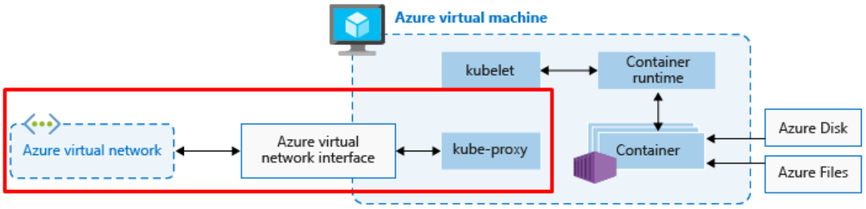
Understand AKS Clusters and Nodes
Azure-managed node provides core Kubernetes services and orchestration
Customer-managed nodes run applications and supporting services
Each individual node is an Azure virtual machine running either Windows or Linux
Notes:
Azure-managed nodes, which provide the core Kubernetes services and orchestration of application workloads.
When you create an AKS cluster, a cluster node is automatically created and configured. This node is provided as a managed Azure resource abstracted from the user. You pay only for running agent nodes
Customer-managed nodes that run your application workloads.
An AKS cluster contains one or more nodes (Azure Virtual Machines) that run the Kubernetes node components and the container runtime.

Slide 36
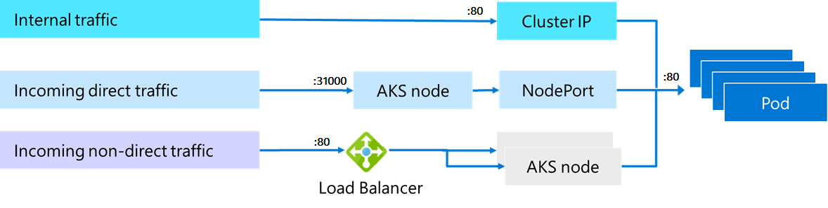
Configure AKS Networking
Pods run an instance of your application
Services group pods together to provide network connectivity
ClusterIP provides internal traffic access
NodePort provides mapping for incoming direct traffic
LoadBalancer has external IP address for incoming non-direct traffic
Notes:
Network concepts for applications in Azure Kubernetes Service (AKS) - https://docs.microsoft.com/azure/aks/concepts-network

Slide 37
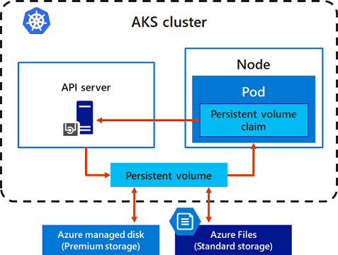
Configure AKS Storage
Local storage on the node is fast and simple to use
Local storage might not be available after the pod is deleted
Multiple pods may share data volumes
Storage could potentially be reattached to another pod
Notes:
Storage options for applications in Azure Kubernetes Service (AKS) - https://docs.microsoft.com/azure/aks/concepts-storage
AKS volumes can be either Azure Disks and Azure Files

Slide 38
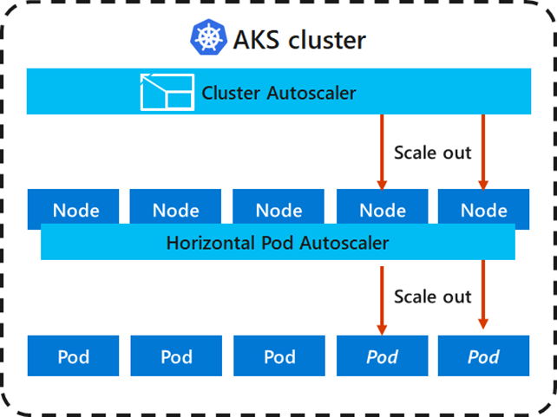
Configure AKS Scaling
Applications might grow beyond the capacity of a single pod
Kubernetes has built-in autoscalers
Cluster autoscaler scales based on compute resources
Horizontal pod autoscaler scales based on metrics
Notes:
Scaling options for applications in Azure Kubernetes Service (AKS) - https://docs.microsoft.com/azure/aks/concepts-scale

Slide 39
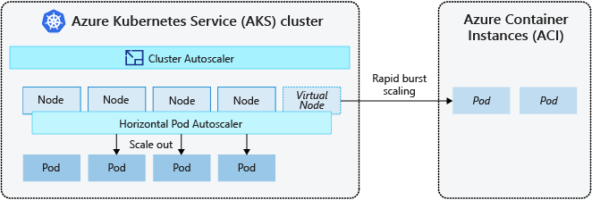
Configure AKS Scaling to ACI
If you need to rapidly grow your AKS cluster, you can create new pods in Azure Container Instances
Notes:
To rapidly scale your AKS cluster, you can integrate with Azure Container Instances (ACI). Kubernetes has built-in components to scale the replica and node count. ACI lets you quickly deploy container instances without more infrastructure overhead. When you connect with AKS, ACI becomes a secured, logical extension of your AKS cluster. Virtual nodes are deployed to another subnet in the same virtual network as your AKS cluster.

Slide 40
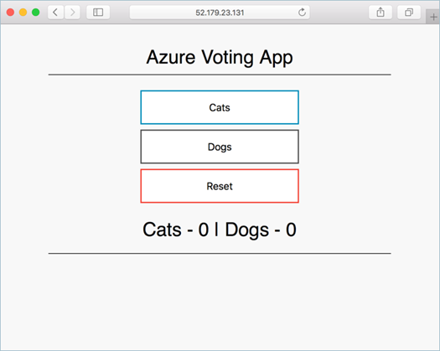
Demonstration – Deploy Azure Kubernetes Service (optional)
Create a Kubernetes service
Connect to the cluster
Test the applications
Notes:
QuickStart: Deploy an Azure Kubernetes Service (AKS) cluster using the Azure portal - https://docs.microsoft.com/azure/aks/kubernetes-walkthrough-portal
✔ Always consider having students walk-through the demonstrations themselves. Also, consider the overlap with the formal labs and your best use of time.

Slide 41
Summary and Resources – Configure Azure Kubernetes Service
Knowledge Check Questions
Microsoft Learn Modules (docs.microsoft.com/Learn)
Introduction to Azure Kubernetes Service
Implement Azure Kubernetes Service (AKS)
Notes:
Learn - https://docs.microsoft.com/learn/browse
The Assessment Guide in the MCT DLC has open-ended questions.
Describe how Azure Kubernetes service pools, nodes, and pods work together.
Answer: Kubernetes is an open-source system for automating deployment, scaling, and management of containerized applications. Azure Kubernetes Service (AKS) makes it simple to deploy a managed Kubernetes cluster in Azure. Nodes are the individual VMs running the containerized applications. Pods are a single instance of an application. The application can contain multiple containers. Pools are groups of nodes with identical configurations. Both pools and nodes can be scaled.

Slide 42
Lab 09a - Implement Web Apps Lab 09b - Implement Azure Container Instances Lab 09c - Implement Azure Kubernetes Service (optional)

Slide 43
Lab 09a – Implement web apps
Lab scenario
You need to evaluate the use of Azure Web apps for hosting Contoso’s web sites, hosted currently in the company’s on-premises data centers. The web sites are running on Windows servers using PHP runtime stack. You also need to determine how you can implement DevOps practices by leveraging Azure web apps deployment slots
Objectives
Task 1: Create an Azure web app
Task 2: Create a staging deployment slot
Task 3: Configure web app deployment settings
Task 4: Deploy code to the staging deployment slot
Task 5: Swap the staging slots
Task 6: Configure and test autoscaling of the Azure web app
Next slide for an architecture diagram
Notes:
LAB 09a - Implement Web Apps - ESTIMATED DURATION 30 MIN
Lab Repository - https://microsoftlearning.github.io/AZ-104-MicrosoftAzureAdministrator/

Slide 44






Lab 09a – Architecture diagram
Task 1
az104-09a-rg1
AppService
AppServiceplan
Production slot
Task 6
Task 5
Swap the staging slot
Autoscale rule
Task 2
Staging slot
Task 4
Task 3
php-docs-hello-world
code
Local git
php-docs-hello-world
code

Slide 45
Lab 09b – Implement Azure Container Instances
Lab scenario
Contoso wants to find a new platform for its virtualized workloads. You identified several container images that can be leveraged to accomplish this objective. Since you want to minimize container management, you plan to evaluate the use of Azure Container Instances for deployment of Docker images
Objectives
Task 1: Deploy a Docker image by using the Azure Container Instance
Task 2: Review the functionality of the Azure Container Instance
Next slide for an architecture diagram
Notes:
LAB 09b - Implement Azure Container Instances - ESTIMATED DURATION 20 MIN
Lab Repository - https://microsoftlearning.github.io/AZ-104-MicrosoftAzureAdministrator/

Slide 46

Lab 09b – Architecture diagram
Task 1
Task 2
az104-09b-rg1
az104-9b-c1

Slide 47
Lab 09c – Implement Azure Kubernetes service (optional)
Lab scenario
Contoso has several multi-tier applications that are not suitable to run by using Azure Container Instances. To determine whether they can be run as containerized workloads, you want to evaluate using Kubernetes as the container orchestrator. To minimize management overhead, you want to test Azure Kubernetes Service, including its simplified deployment experience and scaling
Objectives
Task 1: Deploy an Azure Kubernetes Service cluster
Task 2: Deploy pods into the Azure Kubernetes Service cluster
Task 3: Scale containerized workloads in the Azure Kubernetes service cluster
Next slide for an architecture diagram
Notes:
LAB 09c - Implement Azure Kubernetes Service - ESTIMATED DURATION 40 MIN
Lab Repository - https://microsoftlearning.github.io/AZ-104-MicrosoftAzureAdministrator/

Slide 48




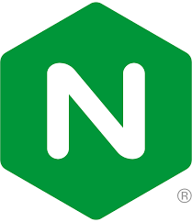



Lab 09c – Architecture diagram
Task 2
az104-09c-rg1
MC_az104-09c-rg1_az104-09c-aks1_region
az104-09c-aks1
Public IP address
Route table
Task 1
CloudShell
Task 3
Kubernetes Load Balancer
NSG
Register the Microsoft.Kubernetes and
Microsoft.KubernetesConfiguration resource providers
Ngnix pod
Task 4
Node Scale Set
AKS Vnet
…
Ngnix pod scale
Node
Node scale

Slide 49

End of presentation

Slide 50
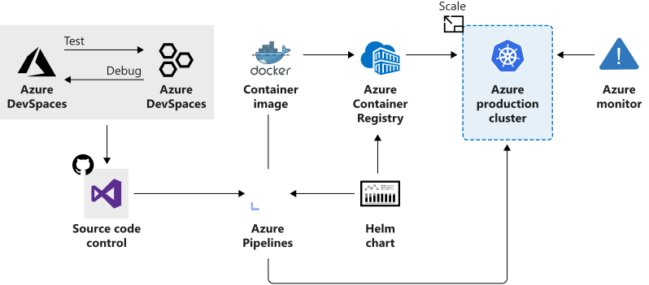
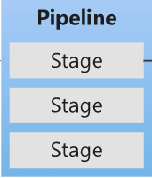
Azure Kubernetes Service
Manages health monitoring and maintenance
Performs simple cluster scaling
Enables nodes to be fully managed by Microsoft
You’re responsible only for managing the agent nodes
You pay only for the agent nodes
Notes:
What is Kubernetes - https://azure.microsoft.com/topic/what-is-kubernetes/
Student Notes:
Kubernetes is a rapidly evolving platform that manages container-based applications and their associated networking and storage components. The focus is on the application workloads, not the underlying infrastructure components. Kubernetes provides a declarative approach to deployments, backed by a robust set of APIs for management operations.
You can build and run modern, portable, microservices-based applications that benefit from Kubernetes orchestrating and managing the availability of those application components. Kubernetes supports both stateless and stateful applications as teams progress through the adoption of microservices-based applications.
As an open platform, Kubernetes allows you to build your applications with your preferred programming language, OS, libraries, or messaging bus. Existing continuous integration and continuous delivery (CI/CD) tools can integrate with Kubernetes to schedule and deploy releases.
Azure Kubernetes Service (AKS) provides a managed Kubernetes service that reduces the complexity for deployment and core management tasks, including coordinating upgrades. The AKS cluster is managed by the Azure platform, and you only pay for the AKS nodes that run your applications. AKS is built on top of the open-source Azure Container Service Engine (acs-engine).
Azure Kubernetes Service (AKS) makes it simple to deploy a managed Kubernetes cluster in Azure. AKS reduces the complexity and operational overhead of managing Kubernetes by offloading much of that responsibility to Azure. As a hosted Kubernetes service, Azure handles critical tasks like health monitoring and maintenance for you. In addition, the service is free, you only pay for the agent nodes within your clusters.
Features
Flexible deployment options : Azure Kubernetes Service offers portal, command line, and template driven deployment options (Resource Manager templates and Terraform). When deploying an AKS cluster, the Kubernetes nodes are deployed and configured for you. Additional features such as advanced networking, Azure Active Directory integration, and monitoring can also be configured during the deployment process.
Identity and security management: AKS clusters support RBAC. An AKS cluster can also be configured to integrate with Azure Active Directory. In this configuration, Kubernetes access can be configured based on Azure Active Directory identity and group membership.
Integrated logging and monitoring: Container health gives you performance visibility by collecting memory and processor metrics from containers, nodes, and controllers. Container logs are also collected. This data is stored in your Log Analytics workspace, and is available through the Azure portal, Azure CLI, or a REST endpoint.
Cluster node scaling: As demand for resources increases, the nodes of an AKS cluster can be scaled out to match. If resource demand drops, nodes can be removed by scaling in the cluster. AKS scale operations can be completed using the Azure portal or the Azure CLI.
Cluster node upgrade: AKS Service offers multiple Kubernetes versions. As new versions become available in AKS, your cluster can be upgraded using the Azure portal or Azure CLI. During the upgrade process, nodes are carefully cordoned and drained to minimize disruption to running applications.

Slide 51
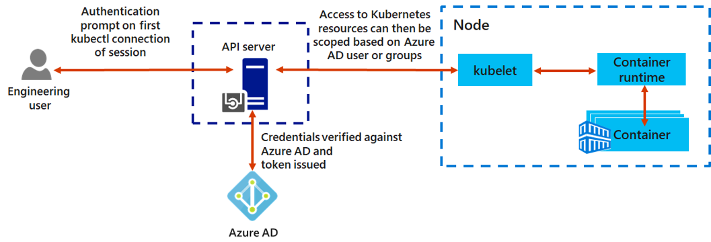
Connect AKS and Azure Active Directory
Use Azure AD as an integrated identity solution
Use service accounts, user accounts, and role-based access control
Notes:
Student Notes:
There are different ways to authenticate with and secure Kubernetes clusters. Using role-based access controls (RBAC), you can grant users or groups access to only the resources they need. With Azure Kubernetes Service (AKS), you can further enhance the security and permissions structure by using Azure Active Directory. These approaches help you secure your application workloads and customer data.
Kubernetes service accounts
One of the primary user types in Kubernetes is a service account. A service account exists in, and is managed by, the Kubernetes API. The credentials for service accounts are stored as Kubernetes secrets, which allows them to be used by authorized pods to communicate with the API Server. Most API requests provide an authentication token for a service account or a normal user account.
Normal user accounts allow more traditional access for human administrators or developers, not just services and processes. Kubernetes itself does not provide an identity management solution where regular user accounts and passwords are stored. Instead, external identity solutions can be integrated into Kubernetes. For AKS clusters, this integrated identity solution is Azure Active Directory.
Azure Active Directory integration
The security of AKS clusters can be enhanced with the integration of Azure Active Directory (AD). Built on decades of enterprise identity management, Azure AD is a multi-tenant, cloud-based directory, and identity management service that combines core directory services, application access management, and identity protection. With Azure AD, you can integrate on-premises identities into AKS clusters to provide a single source for account management and security.
Role-based access controls (RBAC)
To provide granular filtering of the actions that users can perform, Kubernetes uses role-based access controls (RBAC). This control mechanism lets you assign users, or groups of users, permission to do things like create or modify resources, or view logs from running application workloads. These permissions can be scoped to a single namespace, or granted across the entire AKS cluster. With Kubernetes RBAC, you create roles to define permissions, and then assign those roles to users with role bindings.
Azure role-based access controls (RBAC)
Another mechanism for controlling access to resources is Azure role-based access controls (RBAC). Kubernetes RBAC is designed to work on resources within your AKS cluster, and Azure RBAC is designed to work on resources within your Azure subscription. With Azure RBAC, you create a role definition that outlines the permissions to be applied. A user or group is then assigned this role definition for a particular scope, which could be an individual resource, a

Slide 52
Configure AKS Security
✓
Implement security across the entire AKS infrastructure
Managed service – Limit access with authorized IP ranges, create a private cluster, use RBAC and Azure AD access
Cluster upgrades – Upgrade the AKS cluster with cordon and drain
Node – Automatic OS security patches, Azure managed disks, pod security policies
Networks – Define ingress controllers with private internal IP addresses, filter the flow of traffic with network security groups
Data – Kubernetes secrets for credentials and keys
Notes:
Security concepts for applications and clusters in Azure Kubernetes Service (AKS) - https://docs.microsoft.com/azure/aks/concepts-security
Student Notes
To protect your customer data as you run application workloads in Azure Kubernetes Service (AKS), the security of your cluster is a key consideration. Kubernetes includes security components such as network policies and Secrets. Azure then adds in components such as network security groups and orchestrated cluster upgrades. These security components are combined to keep your AKS cluster running the latest OS security updates and Kubernetes releases, and with secure pod traffic and access to sensitive credentials.
Azure component security
Each AKS cluster has their own single-tenanted, dedicated Kubernetes node to provide the API Server, Scheduler, etc. This node is managed and maintained by Microsoft. By default, the Kubernetes API server uses a public IP address and with fully qualified domain name (FQDN). You can control access to the API server using Kubernetes role-based access controls and Azure Active Directory.
Node security
AKS nodes are Azure virtual machines that you manage and maintain. When an AKS cluster is created or scaled up, the nodes are automatically deployed with the latest OS security updates and configurations.
Nodes are deployed into a private virtual network subnet, with no public IP addresses assigned. For troubleshooting and management purposes, SSH is enabled by default. This SSH access is only available using the internal IP address. Azure network security group rules can be used to further restrict IP range access to the AKS nodes. Deleting the default network security group SSH rule and disabling the SSH service on the nodes prevents the Azure platform from performing maintenance tasks.
To provide storage, the nodes use Azure-managed Disks. For most VM node sizes, these are Premium disks backed by high-performance SSDs. The data stored on managed disks is automatically encrypted at rest within the Azure platform. To improve redundancy, these disks are also securely replicated within the Azure datacenter.
Cluster upgrades
For security and compliance, or to use the latest features, Azure provides tools to orchestrate the upgrade of an AKS cluster and components. This upgrade orchestration includes both the Kubernetes Azure-managed and customer-managed agent components. You can view a list of available Kubernetes versions for your AKS cluster. To start the upgrade process, you specify one of these available versions. Azure then safely cordons and drains each AKS node and performs the upgrade.

Slide 53
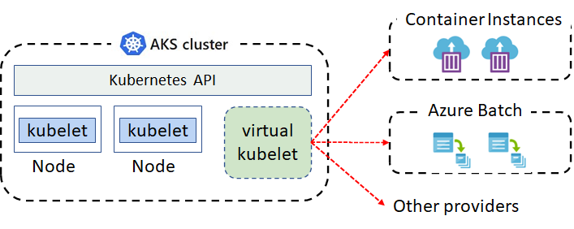
Virtual Kubelet
Virtual kubelet is an open-source Kubernetes kubelet implementation
The virtual kubelet registers itself as a node and allows developers to deploy pods and containers with their own APIs
Supported by an ecosystem of providers
Notes:
Virtual Kubelet Introduction - https://azure.microsoft.com/resources/videos/azure-friday-virtual-kubelet-introduction/
Student Notes
Virtual kubelet is an open-source Kubernetes kubelet implementation that masquerades as a kubelet.
n the above example, the virtual kubelet lets us back our Kubernetes cluster with services. These services then host our individual nodes on behalf of the cluster.​ These services can include Container Instances, and Azure Batch. The virtual kubelet registers itself as a node and allows developers to deploy pods and containers with their own APIs. This lets the virtual kubelet provide a shim layer with a pseudo-kubelet implementation. This process lets you use other services for your individual instances.
Provider list
Azure Batch​
Container Instances​
Alibaba Cloud Elastic Container Instance (ECI)​
AWS Fargate​
Kubernetes Container Runtime Interface (CRI)​
Huawei Cloud Container Instance (CCI)​
HashiCorp Nomad​
OpenStack Zun
Custom provider

Slide 54


Explore Continuous Integration and Deployment
Work in a single source control
Continuous Deployment
Whenever code updates are pushed to the source control, then the website or web app will automatically pick up the updates
Developer 1
GitHub
A continuous deployment workflow publishes the most recent updates from a project
Website
Or similar single source control
Use the portal for continuous deployments from GitHub, Bitbucket, or Azure DevOps
Developer 2
Notes:
Continuous deployment - https://github.com/projectkudu/kudu/wiki/Continuous-deployment#setting-up-continuous-deployment-using-manual-steps

Slide 55
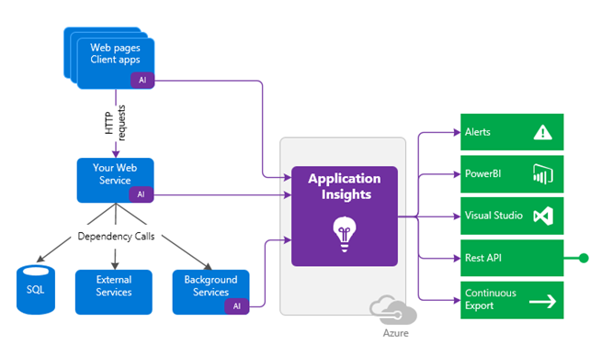
Use Application Insights
Request rates, deny rates, response time and failure rates
Page views and load performance
User and session counts
Performance counters
Diagnostics and Exceptions
Notes:
What is Application Insights? - https://docs.microsoft.com/azure/azure-monitor/app/app-insights-overview

Slide 56
Compare Containers to Virtual Machines (replaced)
Feature | Containers | Virtual Machines
Isolation | Typically provides lightweight isolation from the host and other containers but doesn’t provide as strong a security boundary as a virtual machine | Provides complete isolation from the host operating system and other VMs. This is useful when a strong security boundary is critical, such as hosting apps from competing companies on the same server or cluster
Operating system | Runs the user mode portion of an operating system and can be tailored to contain just the needed services for your app, using fewer system resources. | Runs a complete operating system including the kernel, thus requiring more system resources (CPU, memory, and storage)
Deployment | Deploy individual containers by using Docker via command line; deploy multiple containers by using an orchestrator such as Azure Kubernetes Service | Deploy individual VMs by using Windows Admin Center or Hyper-V Manager; deploy multiple VMs by using PowerShell or System Center Virtual Machine Manager
Persistent storage | Use Azure Disks for local storage for a single node, or Azure Files (SMB shares) for storage shared by multiple nodes or servers | Use a virtual hard disk (VHD) for local storage for a single VM, or an SMB file share for storage shared by multiple servers
Fault tolerance | If a cluster node fails, any containers running on it are rapidly recreated by the orchestrator on another cluster node | VMs can fail over to another server in a cluster, with the VM’s operating system restarting on the new server
Notes:
Containers vs. virtual machines - https://docs.microsoft.com/virtualization/windowscontainers/about/containers-vs-

